Slide 1
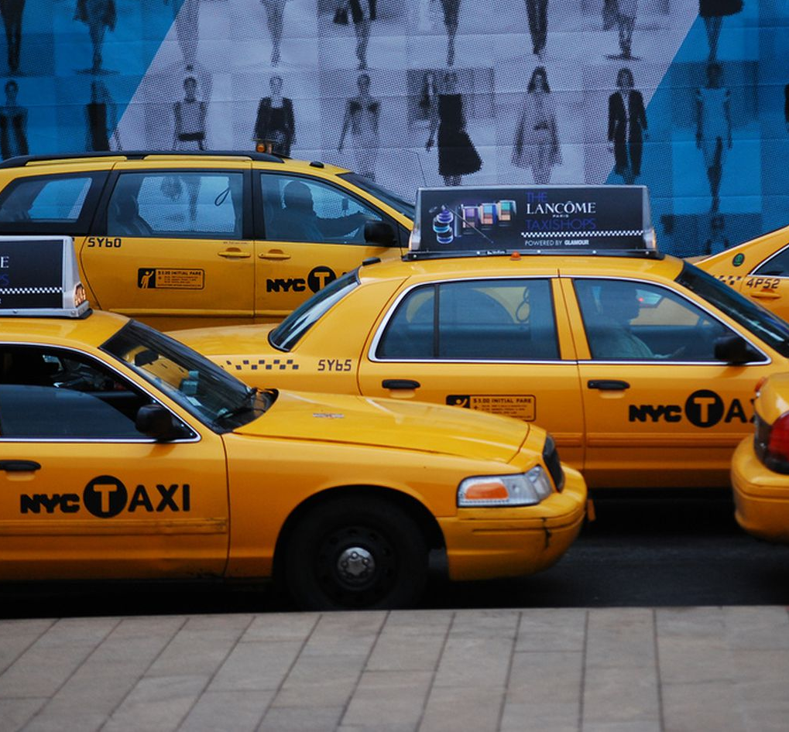
Demand Analysis on NYC Yellow Cab
BYGB 7967 - Fall 2018
DATA MINING FOR BUSINESS

Slide 2
Abstract
Introduction
Problem Statement
Data Description
Methodology
Results and Conclusion
Project Timeline
Q&A

Slide 3
Introduction
Yellow Cab
Pizza
Broadway Show
Empire State Building
Icon of New York City

Slide 4

Yellow Cab no longer reigns 13,857 Yellow Cab shared among 40,000 drivers 311,305 rides per day while…… 46,000 of 60,000 cars connected to Uber 226,046 rides per day

Slide 5


Why Yellow Cab is losing NYC?
Yellow Cab
Lack of real-time supply-demand transparency
Lack of price incentives
Lack of high quality service incentives
Uber (app-based)
Match supply with demand
Surging price during peaks
Reply on customer reviews

Slide 6

Problem Statement
Help Yellow Cab recognize taxi demand factors
Optimize Yellow Cab’s revenue
Conduct analysis by data mining taxi trip records; Target pick-up location density as taxi demand

Slide 7

Data Description
NYC Yellow Cab Taxi Trip Records
Time Span: Jan.2017 – June. 2017
Size: 58,978,882 records
Format: CSV file
Attributes: 17
pick-up and drop-off dates/times, pick-up and drop-off locations, trip distances, itemized fares, rate types, payment types, and driver-reported passenger counts.
Source: NYC Taxi and Limousine Commission
http://www.nyc.gov/html/tlc/html/about/trip_record_data.shtml

Slide 8

Data Description
NYC Climatological Observation Records
Time Span: Jan.2017 – June. 2017
Size: 181 daily records
Format: PDF file
Attributes: 6
historical daily temperature, precipitation, snowfall, wind, evaporation, soil temperature
Source: National Center for Environmental Information https://www.ncdc.noaa.gov/data-access

Slide 9
Methodology
Data Collection
Data Processing
Variable Selection
Model Building
Evaluation

Slide 10
Methodology
Data Collection
NYC Yellow Cab Taxi Trip Records
NYC Climate Data
Data Cleaning
Compile Attributes, Eliminate Invalid Values,
Convert Values to Natural Language
Variable Selection:
Depending on Information Gain
Visualization & Suggestion
Data Integration on “Date” key
Expected vs. Results Results Interpretation
Decision Tree
Neural Network
Bayesian Model
Cross-Validation
Confusion Matrix
ROC Curve

Slide 11
Data Processing
01
SPSS
+ Append 6-Month Data (58Million)
+ Merge WEATHER & Taxi Records
+ Aggregate 58Mio to 46K to15K
(Sacrifice trivial attributes)
02
Python
+ Txt I/O
+ Compile Attributes
Time → ‘Time Slot’
Day → ‘Holiday Y/N’
Calculate →Average Speed’

Slide 12
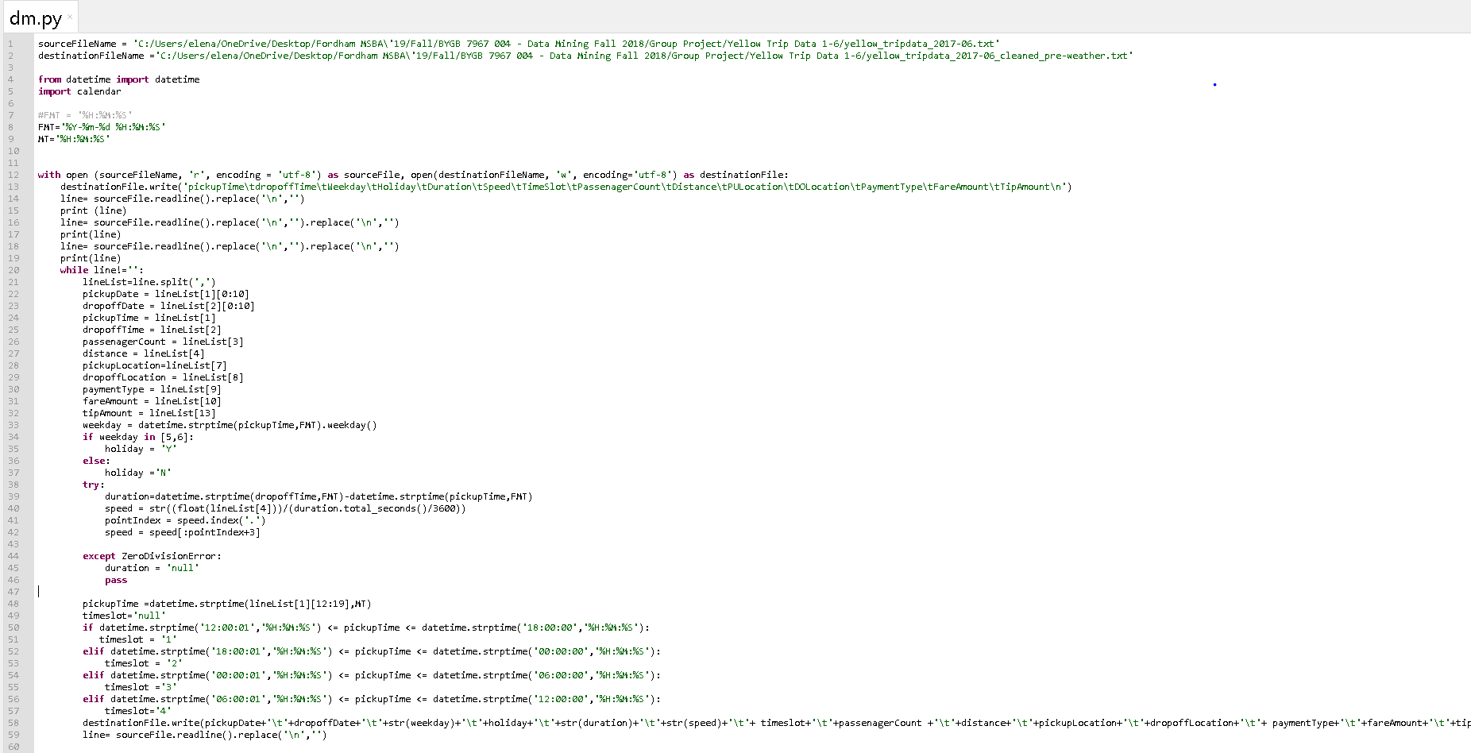

Slide 13
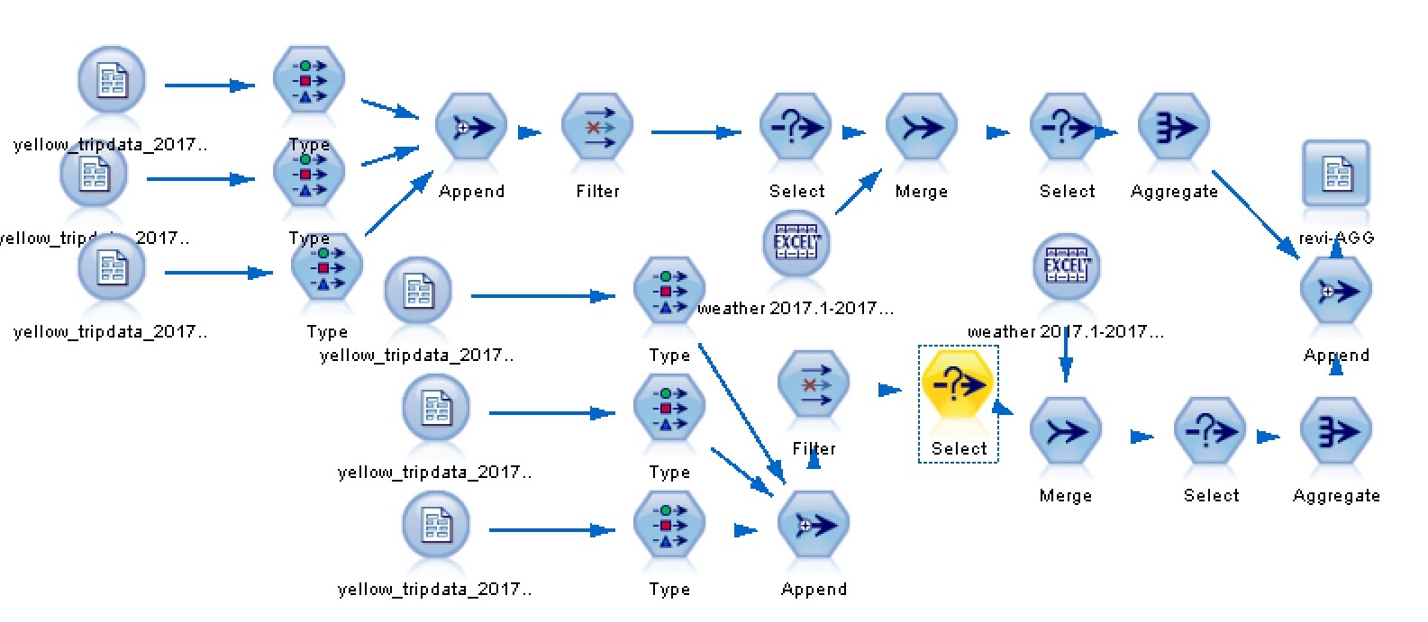

Slide 14
Variable Selection
Drop-off location
Time slot
Traffic condition
Work day/off-work day
Weather condition

Slide 15
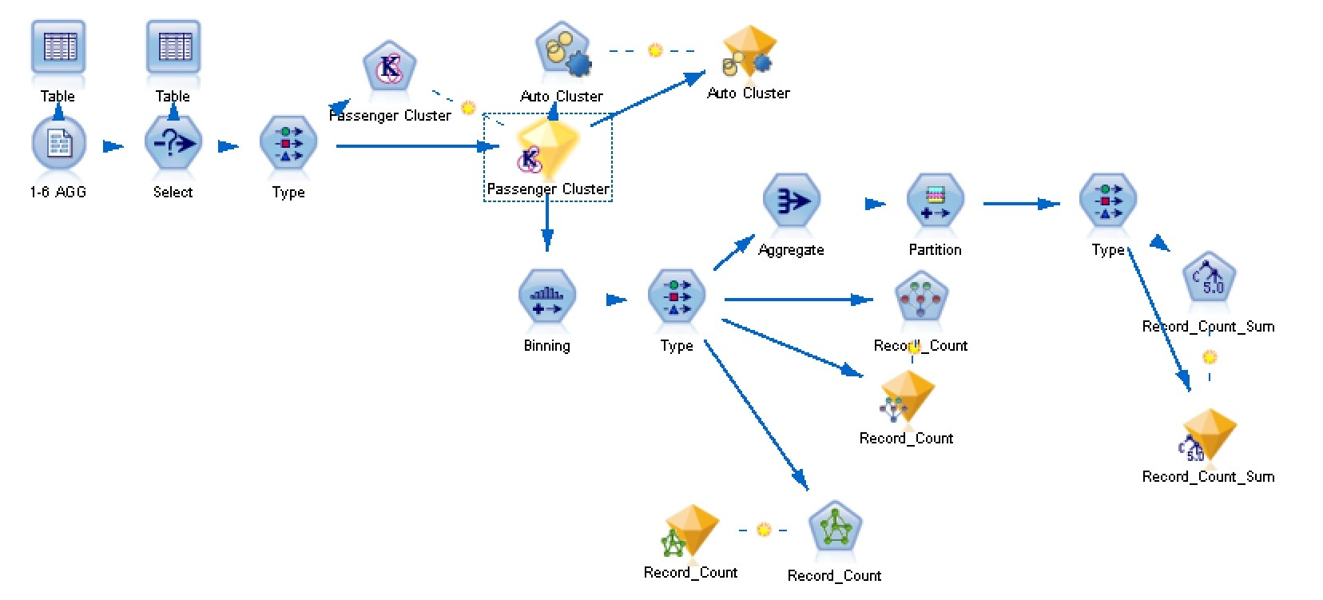
Stream Summary

Slide 16

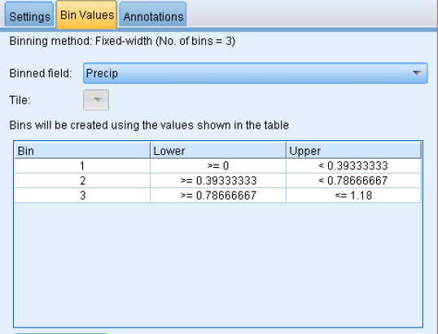
‘Binning’
BIN WEATHER
from CONTINUOUS FIGURE to CATEGORICAL FIGURE

Slide 17
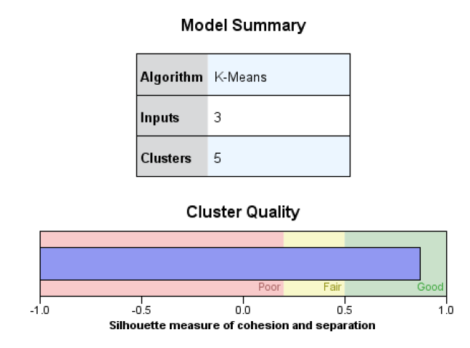
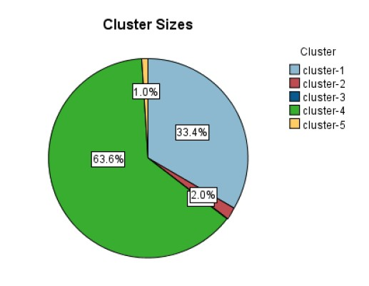
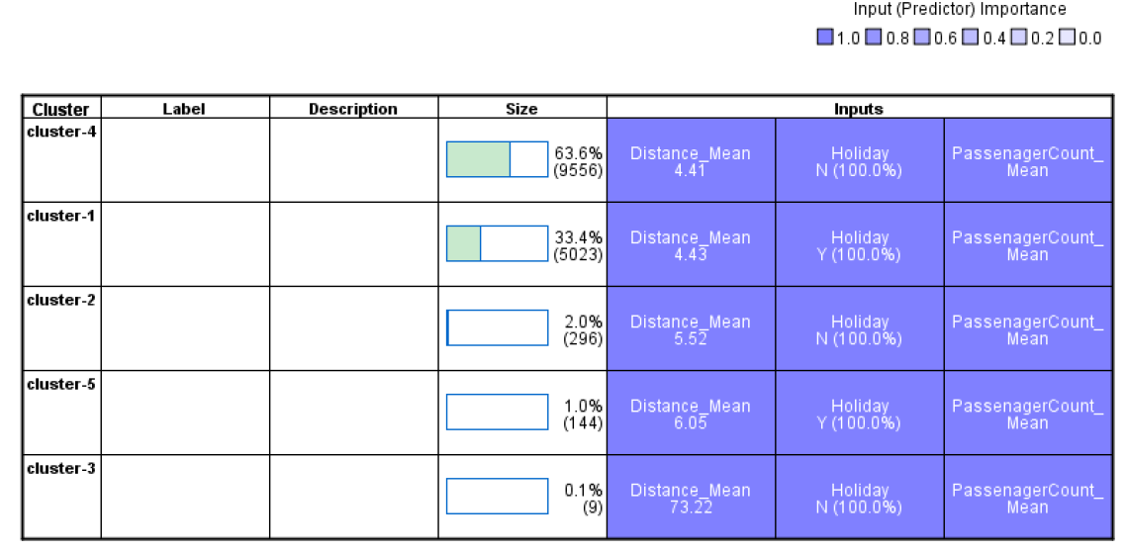
Clustered as new attributes

Slide 18
Model Building Partition 70% for training 30% for testing
Decision Tree
Neural Network
Bayesian Model

Slide 19

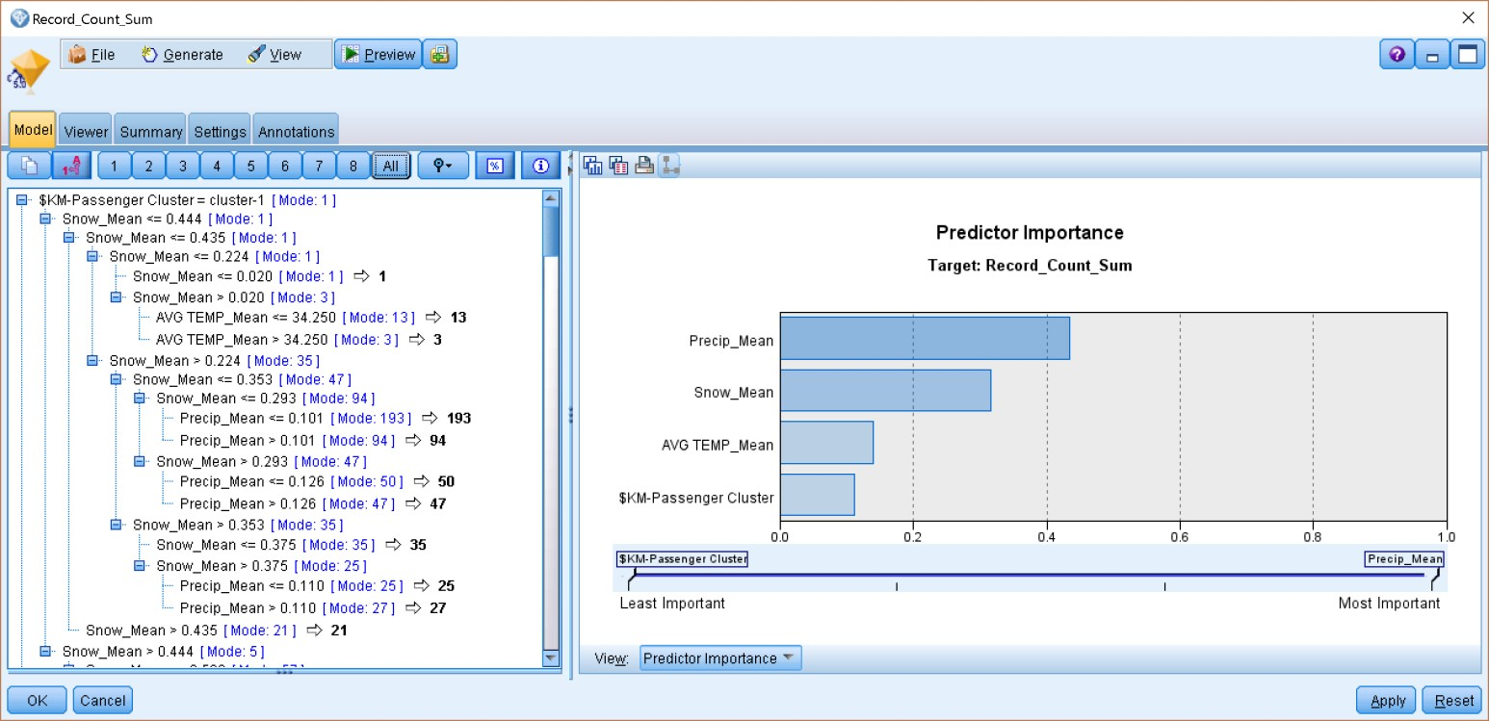
Decision Tree
Aggregate Data
Partition 70% Training 30%Testing
Predictor Importance

Slide 20
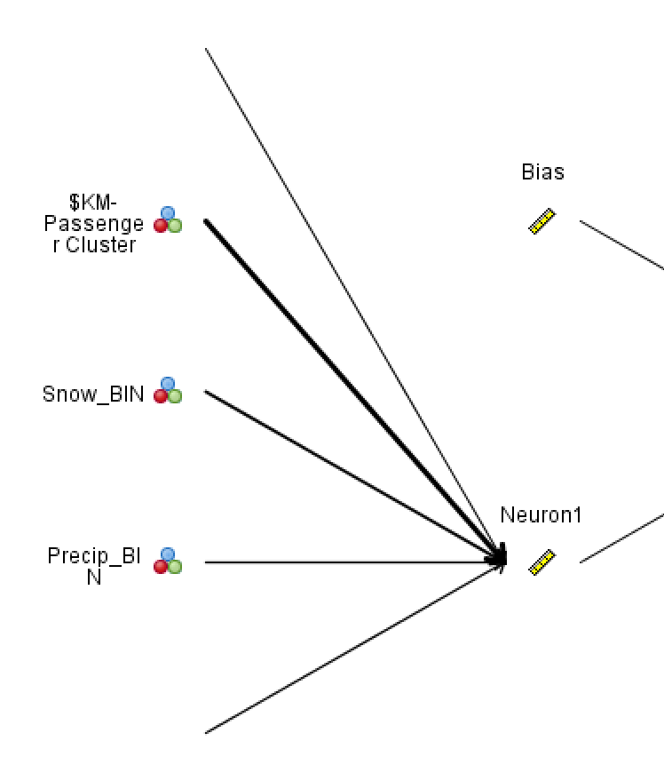
Neural Network
-

Slide 21
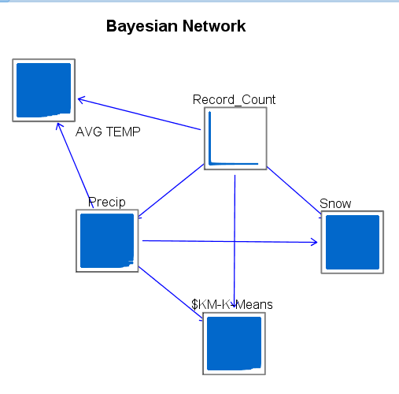
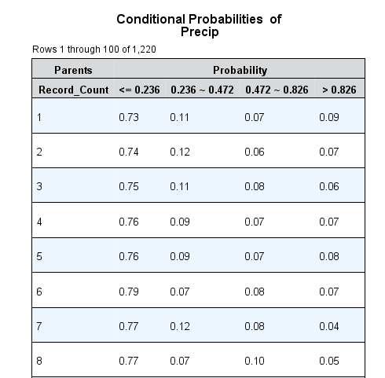

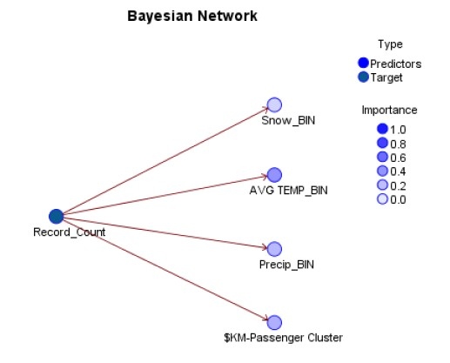
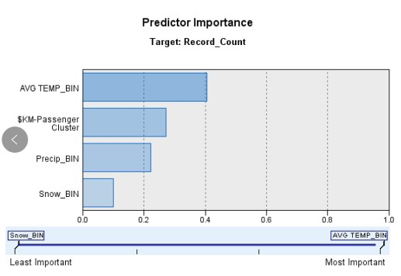
Bayesian Model
Binning Weather
Predictor Importance
Conditional Possibility

Slide 22
Evaluation
Evaluate the model with its accuracy & overfit issues
Cross-Validation - Average accuracy for testing
Confusion Matrix - Compare training accuracy vs. testing accuracy
ROC curve - Intuitive performance
Compare different models, pick the optimal model with best accuracy
Think about the reasoning behind the prediction
Visualize the results in Tableau

Slide 23
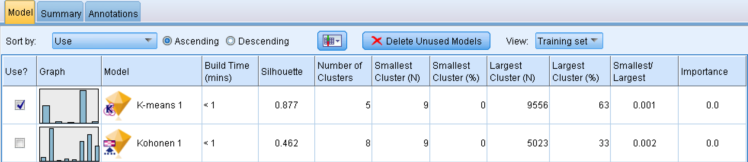
Cluster Evaluation

Slide 24
Tableau

Slide 25
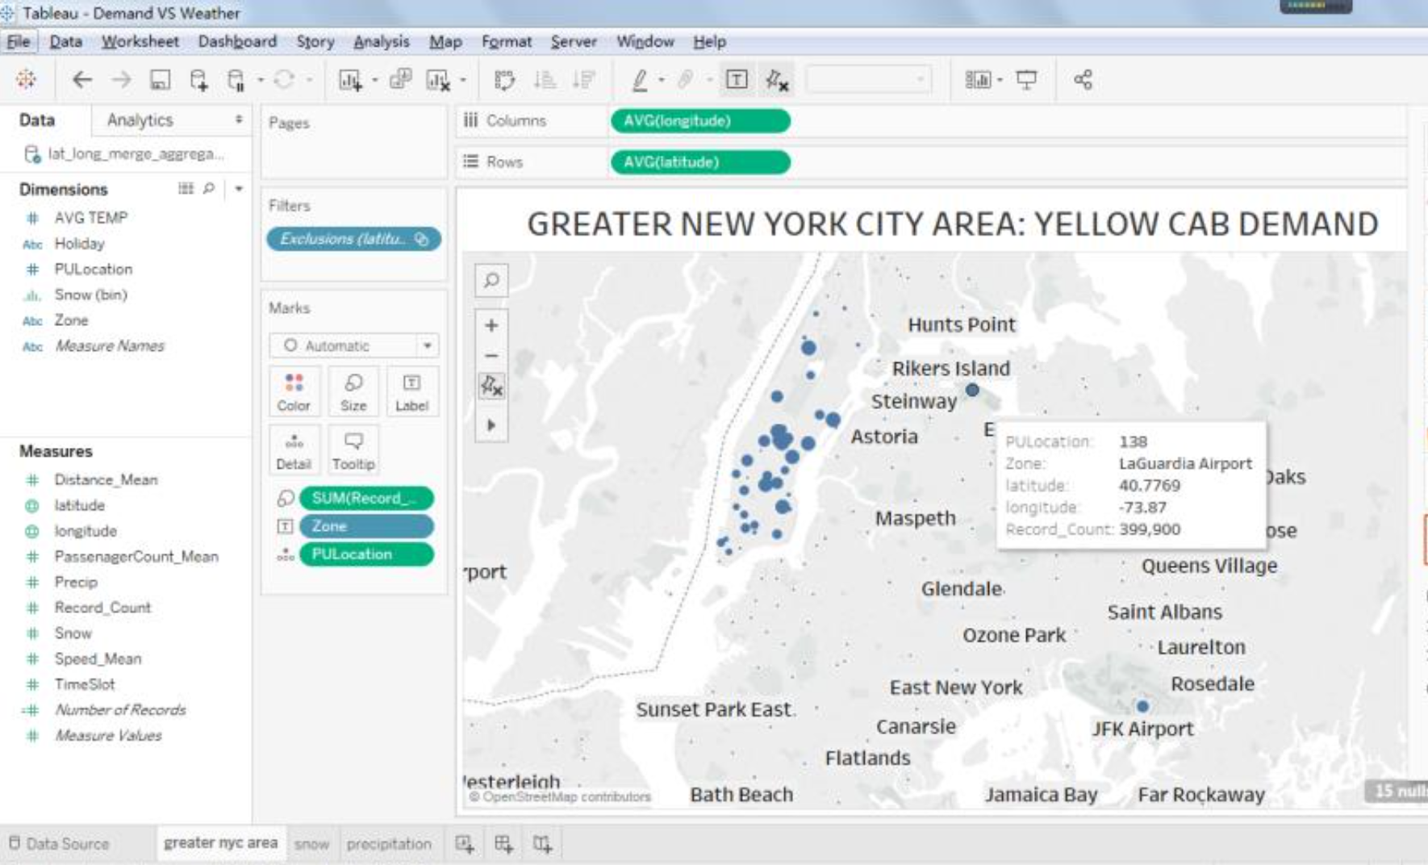
Notes:
In our first Tableau sheet, we displayed the Yellow Cab’s demand across the Greater New York City Area, where each blue circle represented the number of requests by customers; the bigger the circle, the more requests there are.
We come to a conclusion that the JFK and LaGuardia Airport, as well as the Lower Manhattan area represent the demand hotspots for Yellow Cab taxis, which is very similar to our own expectations.

Slide 26
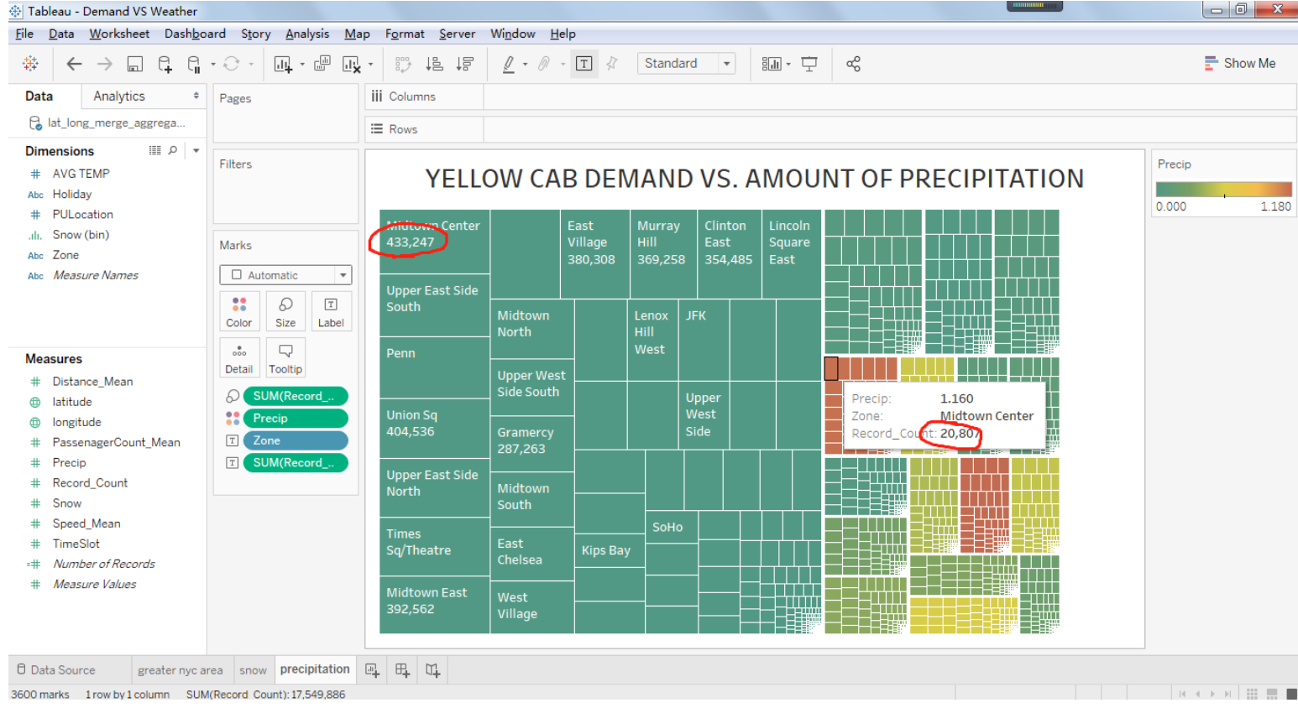
Notes:
We assumed bad weather condition, such as rain, positively affects taxi demand since people try to reach their destination as soon as possible without any exposure to the rain and prefer a more comfortable way to commute.
However, the result surprised us since there are less transactions if it rains or snows, which disproves our initial assumptions.
We tried to explain this phenomenon from two perspectives: there are less people who want to go outside when it is rainy, so the number of orders is less than under normal weather; also, our background research complements our findings in that Yellow Cab taxi drivers are passive responding to customers, while Uber drivers are more active. This principle also applies to precipitation analysis.

Slide 27
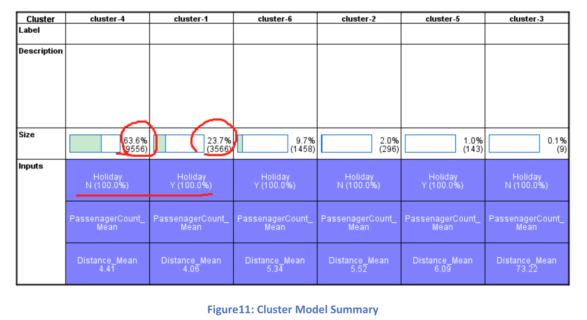
Notes:
From common sense, the taxi demand is higher during workday instead of off-work day since people are more limited to time and need to rush to their next destination.
Cluster results validate this assumption. A majority of people seem to request a cab during a workday, while half of Cluster 4 will get cabs on holidays. Thus, the taxi demand is extremely high on workdays.

Slide 28

Result & Conclusion
The taxi demand is higher during workday instead of off-work day (people are more limited by time and need to rush to next destination)
Bad weather condition such as rainy decrease demand (people try to reach destination as soon as possible without outdoor exposure)
Pick-up location for Yellow Cab mostly occurs in Manhattan Upper East, Time Square and airports. Concentrate in commercial areas, where there are shopping malls, theaters, concentration of restaurants.

Slide 29
Project Timeline
10/30/2018
11/05/2018
11/08/2018
11/16/2018
11/20/2018
11/25/2018
Data Collection
Data Processing
Variable Selection
Model Building
Evaluation
Implementation
Browse datasets in interested domain
Determine datasets and problem statement
Download datasets along with data dictionaries
Design Proposal
Clean data: eliminate unreasonable data
Compile attributes: necessary calculation and convert to natural language
Integrate two datasets ensuring consistency
Attributes selection based on researches
Eliminate unrelated fields such as Vendor ID
Confirm attribute types and noise data
Run Decision Tree Model
Run Neural Network
Run Bayesian Model
Results interpretation
Cross-Validation for training model
Interpret Confusion Matrix
Conduct ROC Curve
Choose the optimal accuracy model
Convert taxi demand in Spatial Distribution using Tableau
Provide Recommendations to meet potential demand
Prepare presentation and project report

Slide 30

Thank you!

